Slide 1
Muhammad Waleed 02-131242-119

Slide 2

AI and Machine Learning in CRM: Revolutionizing Customer Relationships
Artificial Intelligence (AI) and Machine Learning (ML) are transforming Customer Relationship Management (CRM) by enabling personalized interactions and insightful data analysis.
This presentation covers AI/ML applications, benefits, and challenges in CRM, showing how businesses can leverage these technologies to enhance customer value and stay competitive.

Slide 3
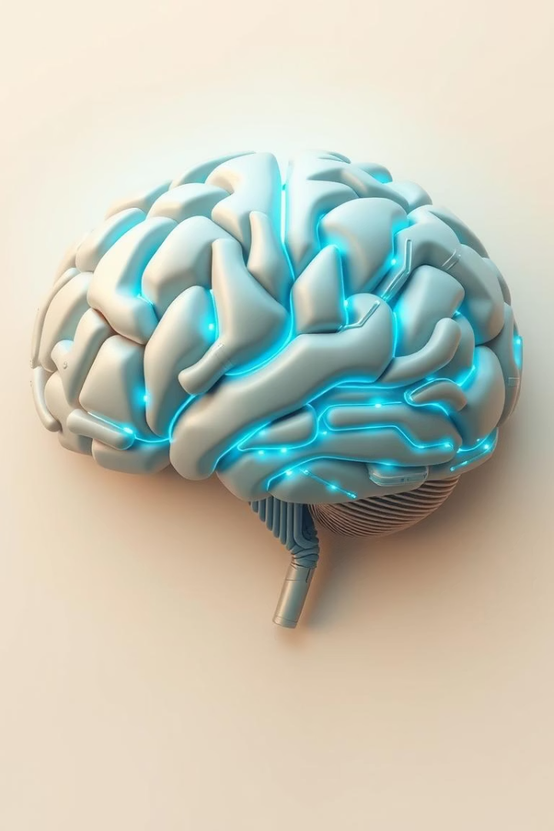
What is AI and Machine Learning?
Artificial Intelligence (AI)
Machine Learning (ML)
Machines simulating human intelligence processes such as reasoning, learning, and problem-solving.
Algorithms enabling computers to learn from data and enhance their performance without explicit programming.
Key Techniques
Natural Language Processing (NLP) for understanding and generating human language
Predictive Analytics to forecast future trends
Deep Learning for complex pattern recognition

Slide 4
Why Integrate AI/ML into CRM?
Growing Data Volumes
Customer Expectations
Competitive and Cost Advantages
Businesses generate 2.5 quintillion bytes of data daily, requiring intelligent systems to process this in real-time. AI and machine learning help CRM analyze vast data, converting it into actionable strategies for personalized engagement and better decisions.
Today, 71% of consumers expect personalized interactions. AI-powered CRMs predict needs and automate communication, enhancing satisfaction and loyalty, while driving revenue through meaningful relationships.
AI adoption in CRM grows 31% annually due to its strategic value. Companies using AI gain 20-30% efficiency, lower costs, and boost productivity, gaining a competitive edge with faster, data-driven decisions and optimized service.

Slide 5

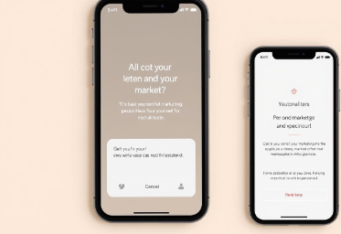
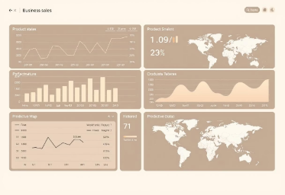

Benefits of AI/ML in CRM
Improved Customer Segmentation
Personalized Marketing Campaigns
Predictive Sales Analytics
Enhanced Customer Service
AI identifies high-value customers by analyzing behaviors and preferences for targeted engagement.
Tailored messages powered by machine learning boost conversion rates and campaign effectiveness.
Forecasts with up to 95% accuracy help optimize sales strategies and forecast revenue.
AI-driven insights allow faster issue resolution, improving overall customer satisfaction.

Slide 6

AI-Powered CRM Applications: Sales
Lead Scoring
AI prioritizes leads with a 68% chance to convert, focusing sales efforts where it matters most.
Sales Forecasting
Predicts quarterly revenue within a 5% margin of error, enabling improved financial planning.
Automated Task Management
Reduces administrative time by 20%, freeing sales teams to concentrate on customer engagement.
Examples
Platforms like Salesforce Einstein and Microsoft Dynamics 365 Sales AI are leaders in this space.

Slide 7

AI-Powered CRM Applications: Marketing
Personalized Email Marketing
AI customizes content to boost click-through rates by 14%, improving campaign ROI.
Customer Segmentation
AI-driven analysis precisely targets demographics, enabling tailored messaging.
Chatbot Integration
Automates round-the-clock customer interactions, enhancing responsiveness and lead capture.
Examples
HubSpot Marketing Hub and Adobe Marketing Cloud demonstrate advanced AI marketing tools.

Slide 8





AI-Powered CRM Applications: Customer Service
Sentiment Analysis
Automated Ticket Routing
Predictive Issue Resolution
Examples
Detects customer frustration in real time, allowing for proactive engagement.
Zendesk and Freshdesk leverage AI to improve service quality and response times.
Instantly assigns tickets to the most appropriate agents, enhancing efficiency.
Automatically addresses common issues before customers report them.

Slide 9

Fraud Detection in CRM Transactions
AI enhances CRM security by detecting fraud swiftly with advanced algorithms, protecting data and trust.
Machine learning continuously analyzes transactions to uncover fraud missed by traditional methods.
AI adapts to new threats, reducing losses and regulatory risks proactively.
Anomaly Detection
Real-Time Alerts
Continuous Learning
Behavioral analytics identify suspicious activity early.
Instant notifications enable quick fraud response.
AI updates detection by learning new fraud patterns.

Slide 10
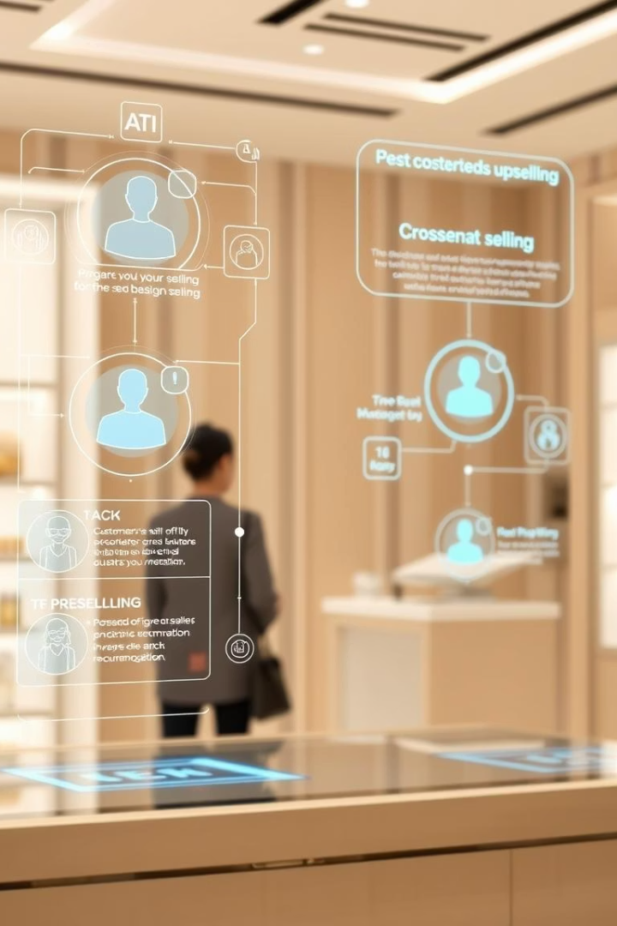
AI for Upselling and Cross-Selling
AI analyzes customer data to identify optimal upsell and cross-sell opportunities based on behavior and preferences.
It delivers personalized recommendations that increase sales and customer value.
Machine learning refines targeting to maximize revenue and strengthen relationships.
AI insights help sales teams prioritize leads and tailor their strategies for better results.

Slide 11

AI Chatbots for Customer Support
AI chatbots are transforming customer support by providing 24/7 instant assistance.
They handle common inquiries, freeing staff to tackle complex issues.
Advanced natural language processing enables personalized, human-like interactions.

Slide 12
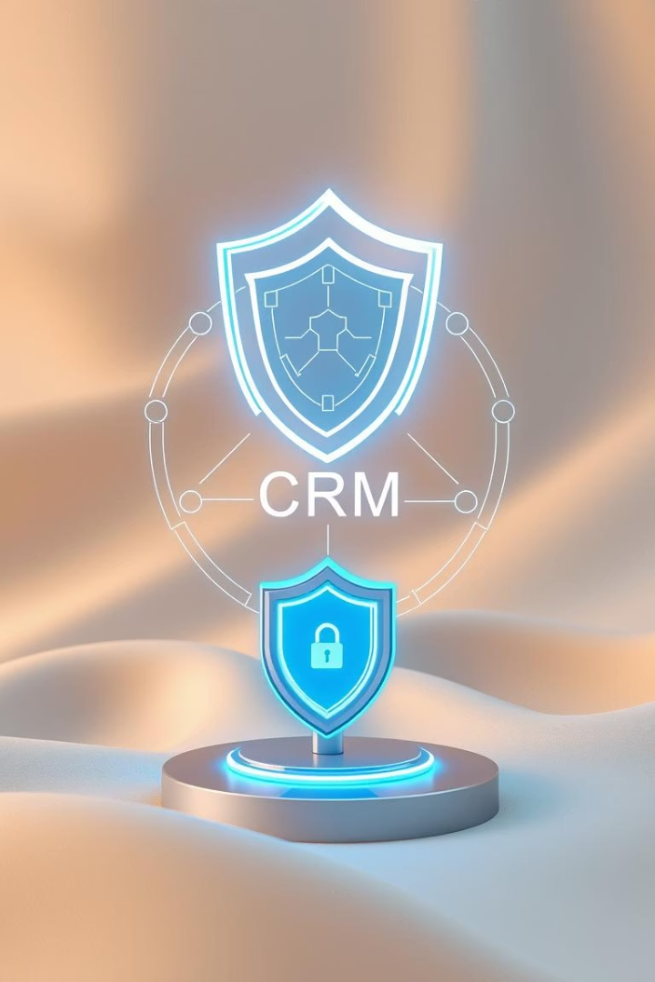
AI in CRM Security and Privacy Management
AI enhances CRM security by detecting threats and suspicious activity in real time through advanced anomaly detection.
Automated tools ensure privacy compliance with standards like GDPR and CCPA.
Machine learning adapts to emerging threats, enabling proactive defense and faster response.
AI enforces strict access controls and auditing, granting data only to authorized personnel with accountability.
Integrating AI security in CRM protects customer trust and manages privacy efficiently across regions.

Slide 13
AI-Driven Loyalty Programs
Personalized Rewards
Predictive Engagement
Data-Driven Insights
AI tailors loyalty incentives by analyzing purchase history, browsing, and engagement to create offers that match individual preferences, enhancing program appeal and effectiveness.
Machine learning forecasts customer needs to boost participation and retention with timely, relevant communications before disengagement or purchases.
AI identifies trends in loyalty data, revealing patterns that help optimize rewards, marketing, and customer experience.

Slide 14
Real-World Examples
Coca-Cola
Sephora
Netflix
Amazon
AI-powered freestyle machines offer personalized drink options by analyzing preferences and purchase history, enhancing engagement.
The Virtual Artist app increases sales by 30% using AR and AI for virtual makeup trials, boosting brand loyalty.
Its AI-driven recommendation engine cuts churn by 6% by personalizing content to viewer habits.
AI-based product recommendations account for 35% of sales, improving the shopping experience and conversions.

Slide 15
Challenges and Considerations
Data Privacy & Security
Algorithm Bias
Compliance with GDPR and CCPA is vital to protect data and trust. Organizations must use encryption, secure storage, and audits to prevent breaches.
Maintaining fairness requires monitoring AI models for bias and using diverse training data to avoid discriminatory outcomes.
Implementation Costs
Skilled Personnel
Planning for software, training, and integration costs is essential, including potential custom development for CRM compatibility.
Qualified data scientists and engineers are needed to deploy and optimize AI systems, supported by ongoing training and multidisciplinary teams.

Slide 16








The Future of AI/ML in CRM
Hyper-Personalization
Predictive Customer Service
AI will predict customer needs more accurately, delivering tailored experiences using real-time, multi-channel data to boost engagement.
AI-powered CRM will detect and resolve issues proactively, enhancing satisfaction and loyalty.
Ethical AI
Voice-based CRM
Focus will grow on fairness, transparency, and accountability to prevent bias and protect privacy.
Voice recognition and NLP will enable hands-free data entry and analysis, simplifying workflows.

